Slide 1

Mathematical Modeling of Disease - COVID19
Presented by Theo N.

Slide 2


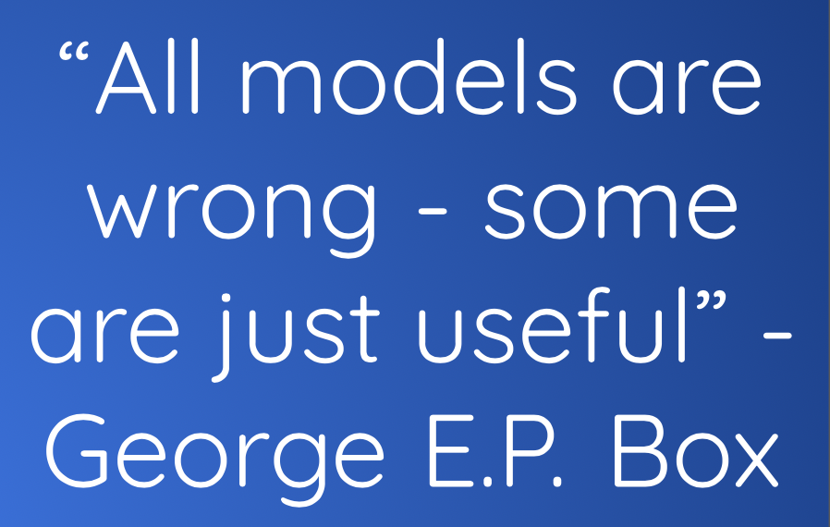
Assumptions

Slide 3


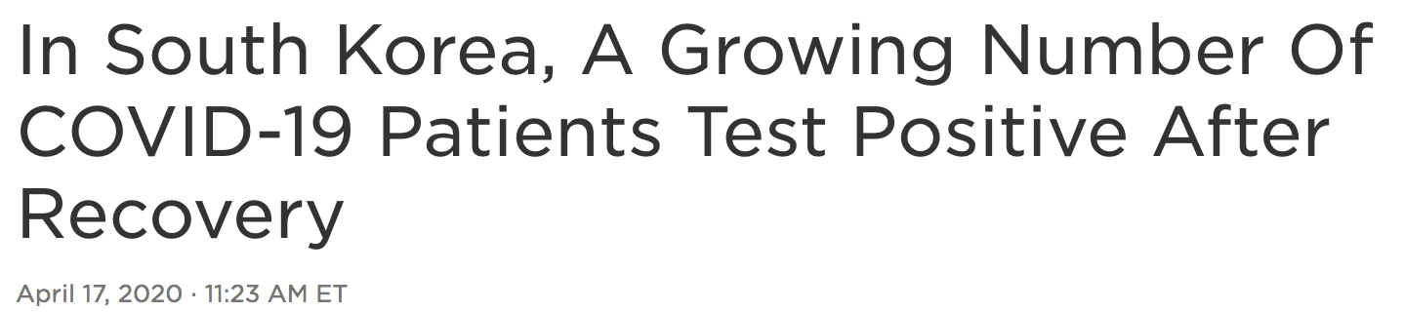
Knowledge
Jan. 29, 2020
April 18, 2020
Mar. 4, 2020
Apr. 17, 2020 - NPR
Notes:
April 18, 2020 - Date this presentation was written

Slide 4
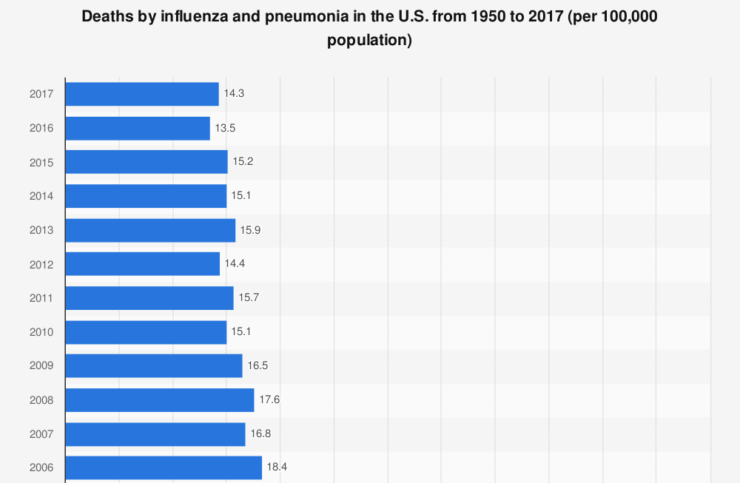
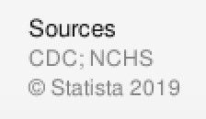
I
N
F
L
U
E
N
Z
A

Slide 5
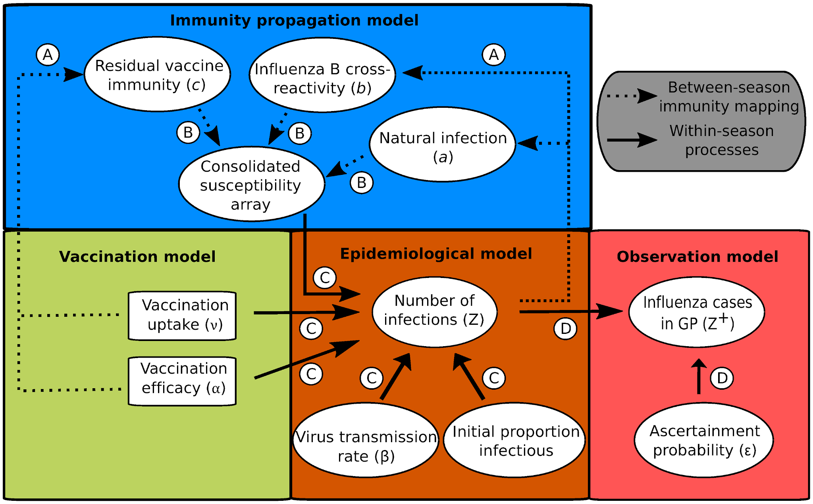
I
N
F
L
U
E
N
Z
A
https://journals.plos.org/ploscompbiol/article?id=10.1371/journal.pcbi.1007096

Slide 6
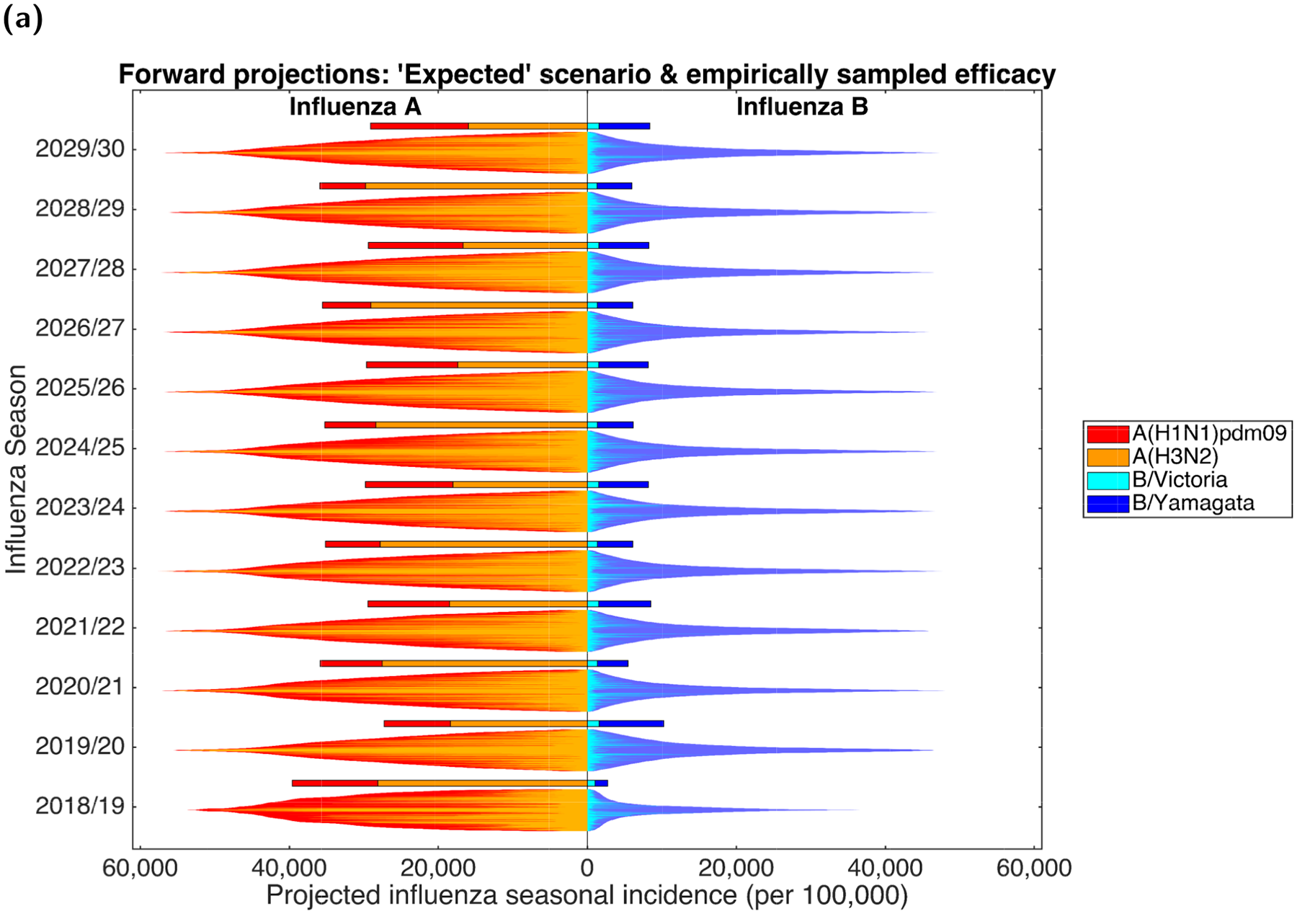
I
N
F
L
U
E
N
Z
A
https://journals.plos.org/ploscompbiol/article?id=10.1371/journal.pcbi.1007096

Slide 7
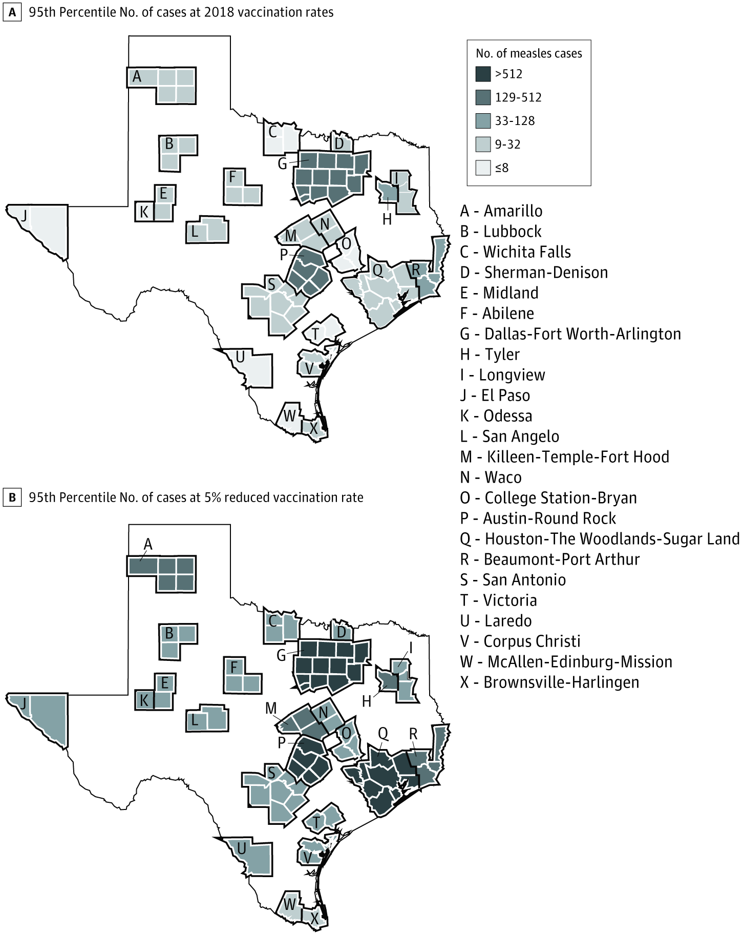
Measles
https://jamanetwork.com/journals/jamanetworkopen/fullarticle/2748595

Slide 8
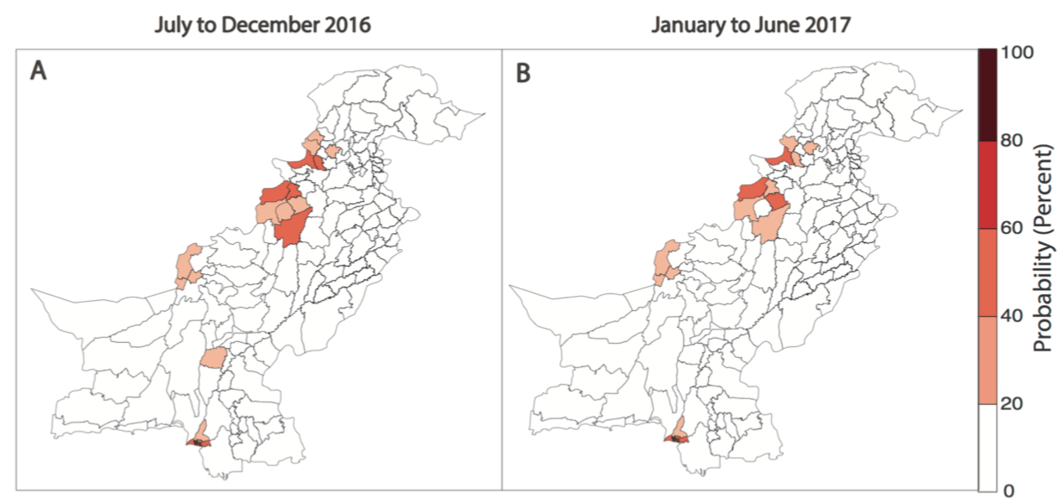
Pakistan
POLIO
https://www.ncbi.nlm.nih.gov/pmc/articles/PMC5467805/

Slide 9
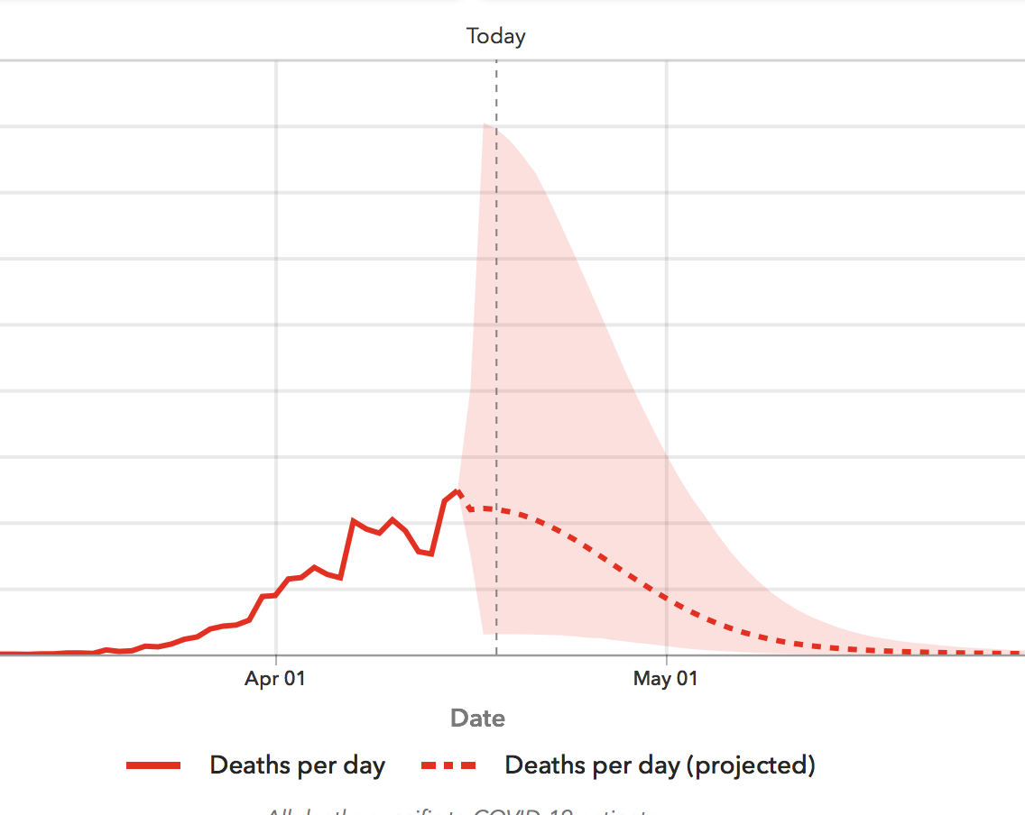
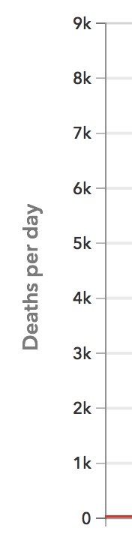
COVID-19
https://covid19.healthdata.org/united-states-of-america

Slide 10
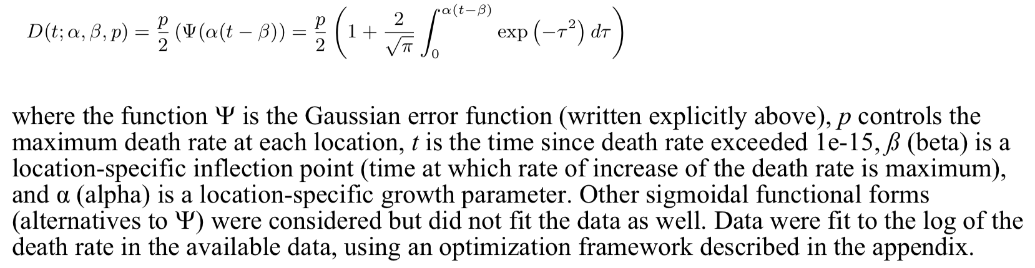
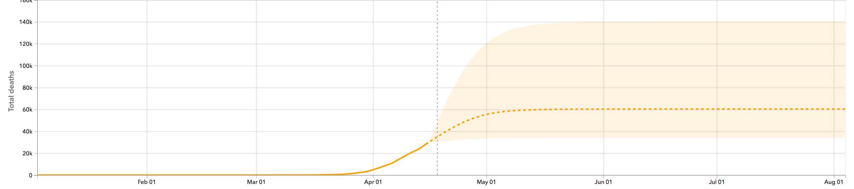
COVID-19

Slide 11
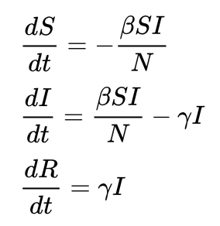
SIRS Mathematics
β = contact rate
𝛾 = “recovery” rate
S ⇾ I ⇾ R

Slide 12
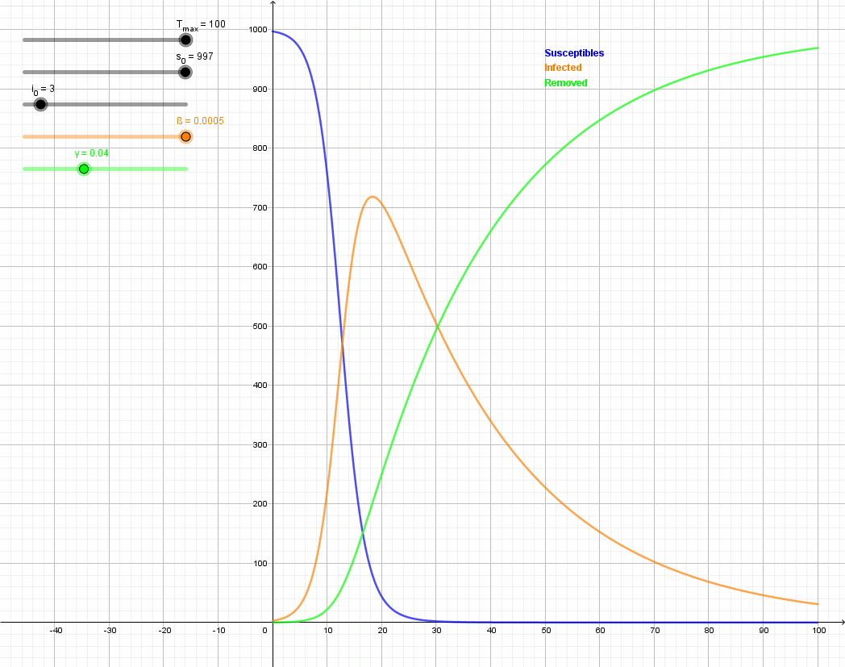
SIR’s Animation

Slide 13
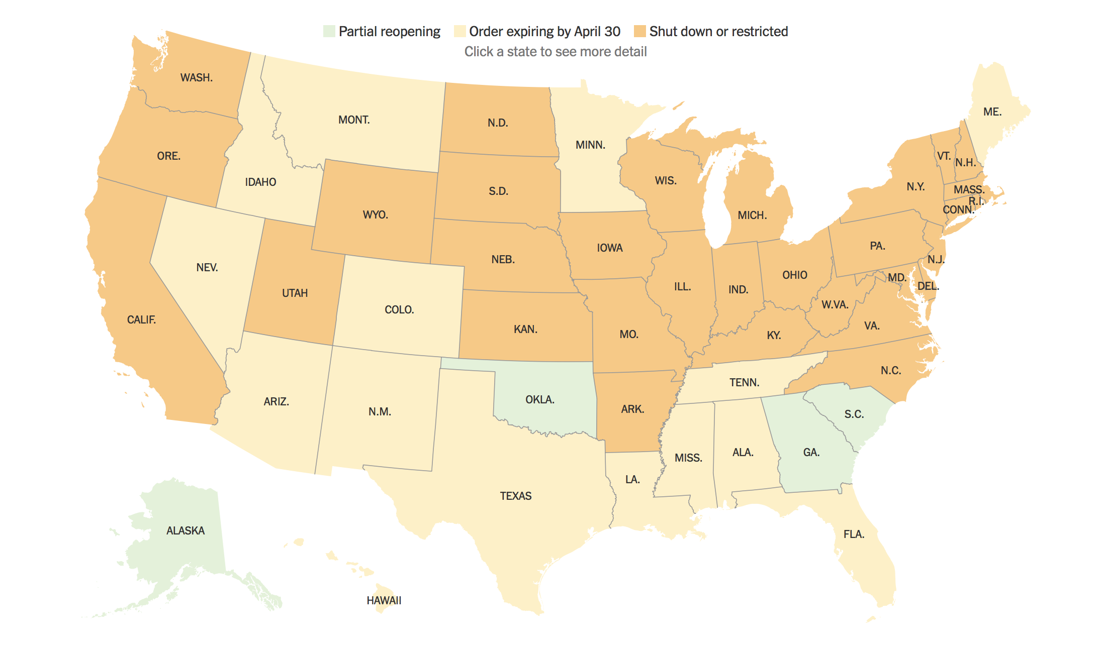
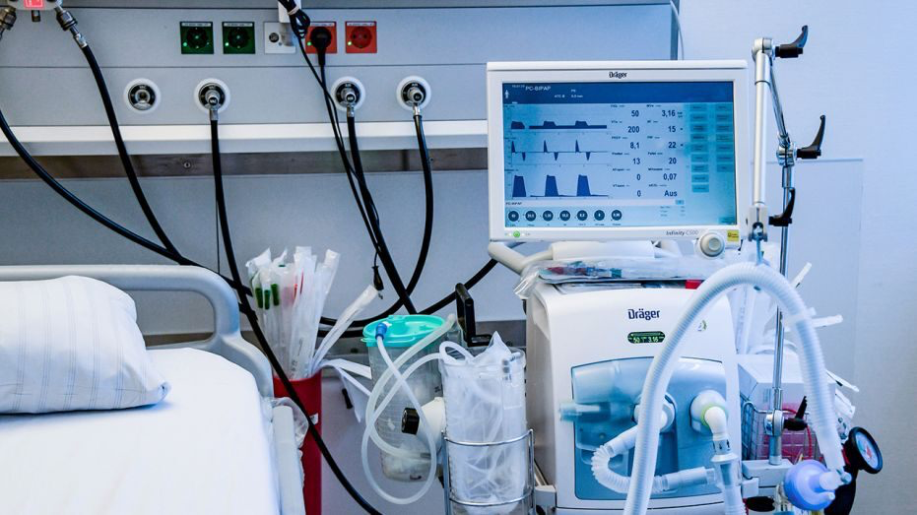
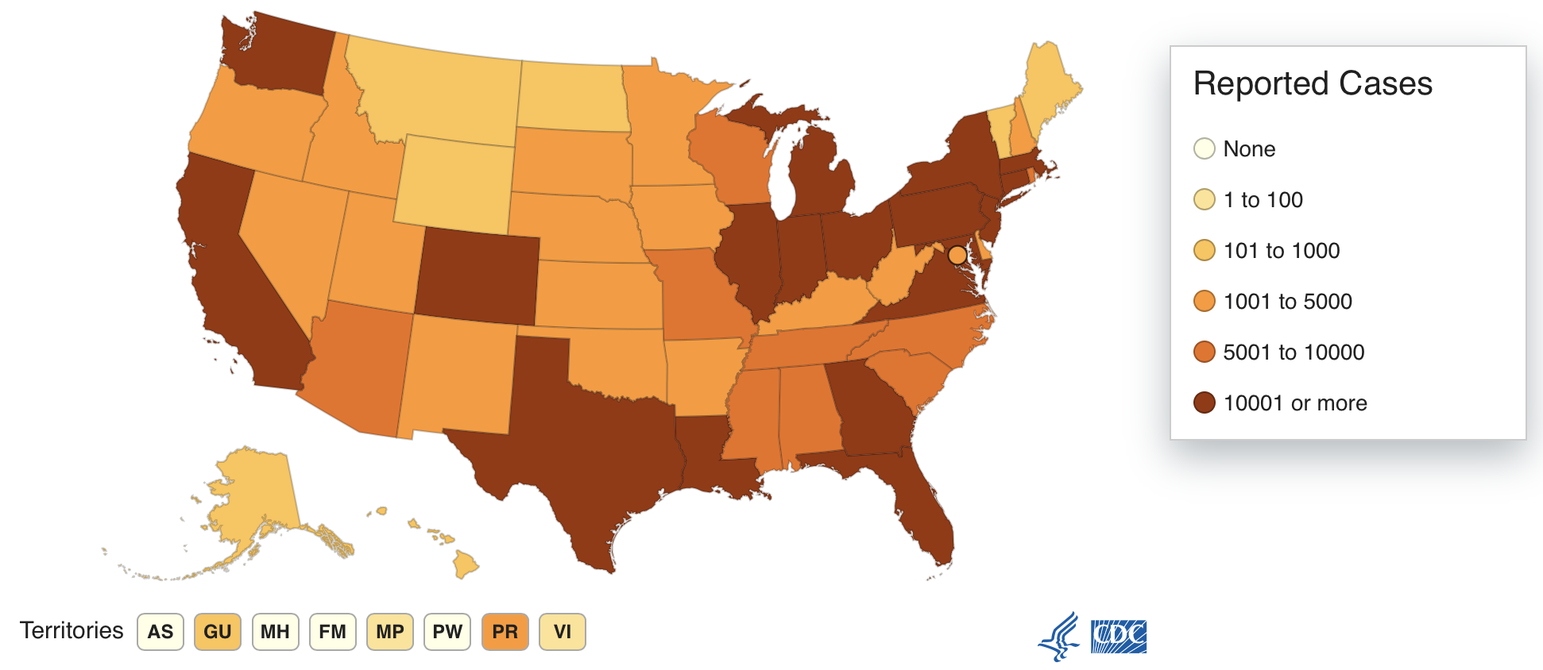
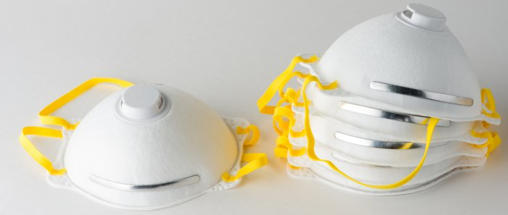
Allocation of Resources

Slide 14
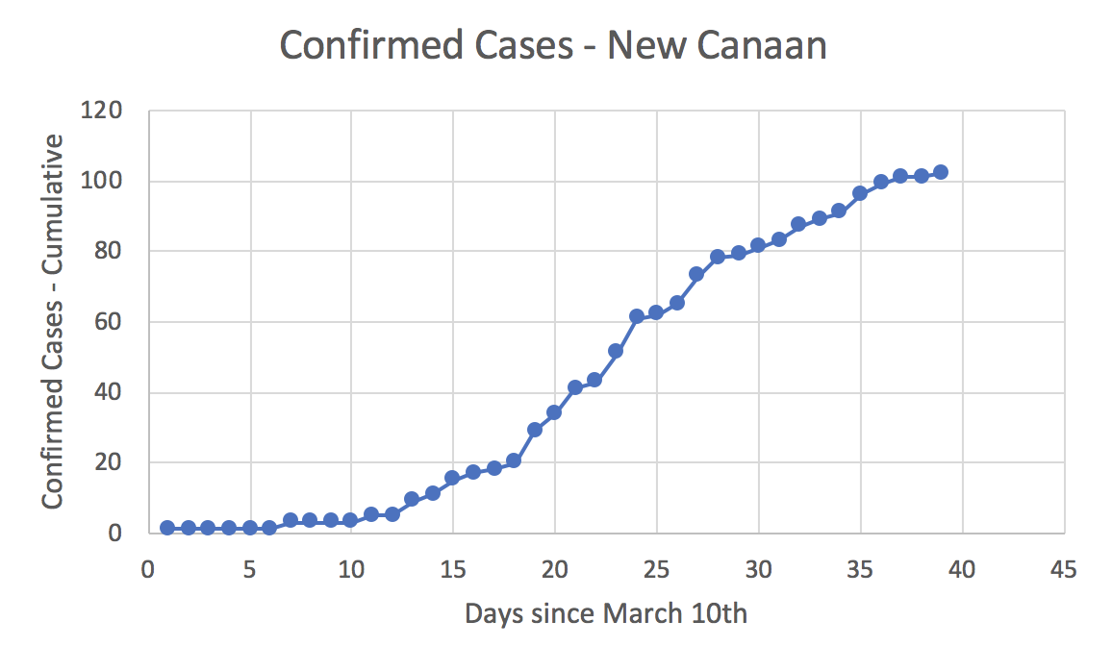
New Canaan Coronavirus Modeling
CT State Gov. Report: March 11th - April 18th, 2020

Slide 15
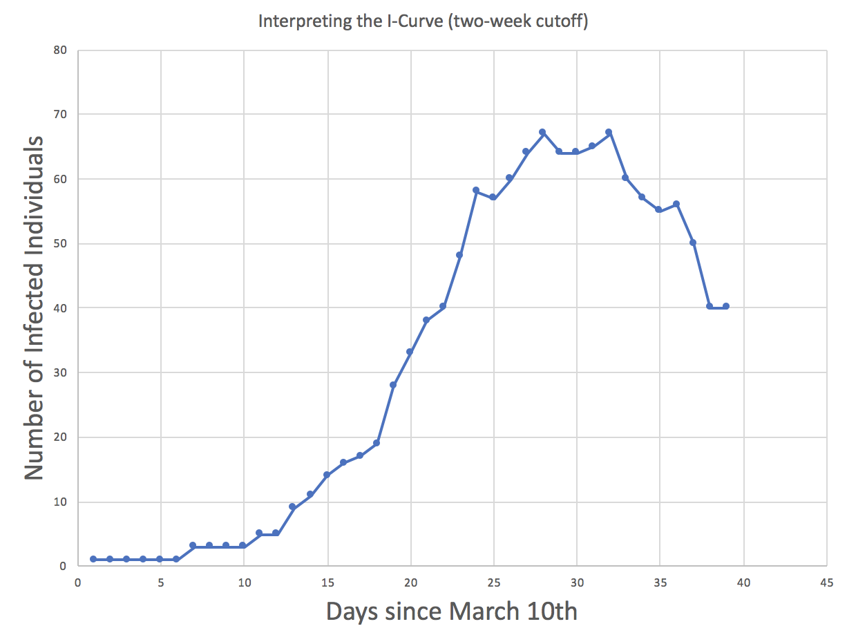
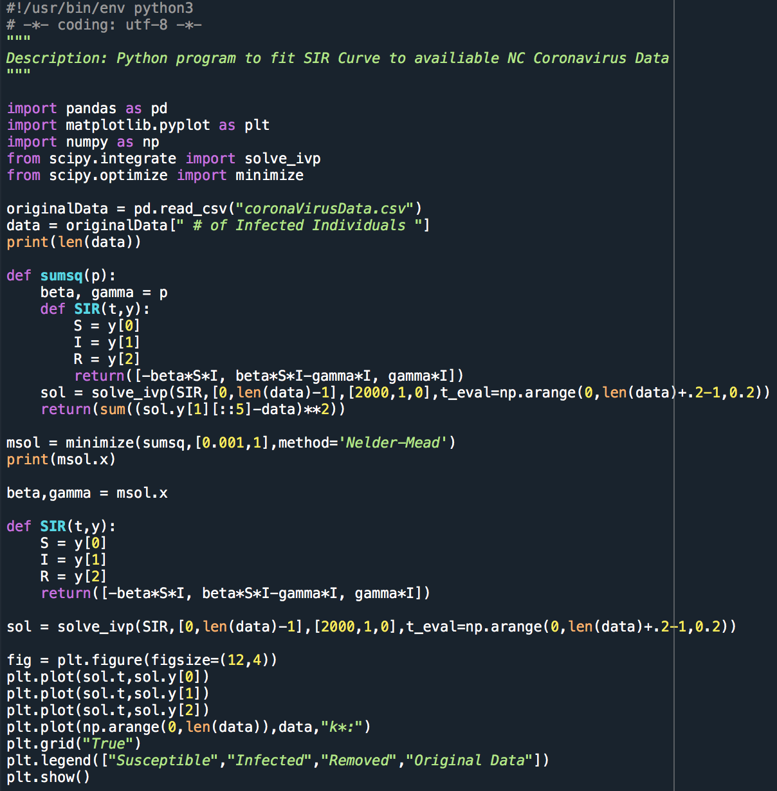
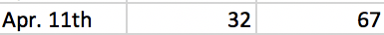
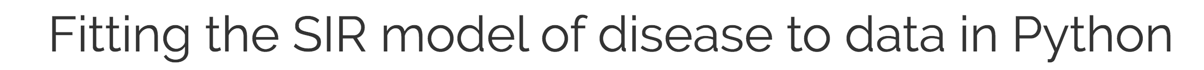
New Canaan Coronavirus Modeling

Slide 16
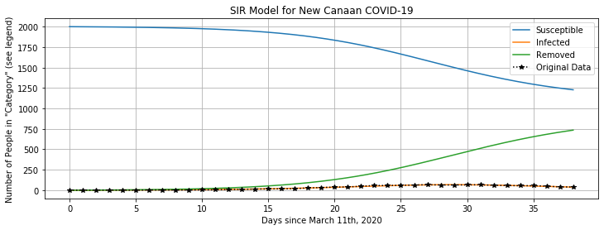
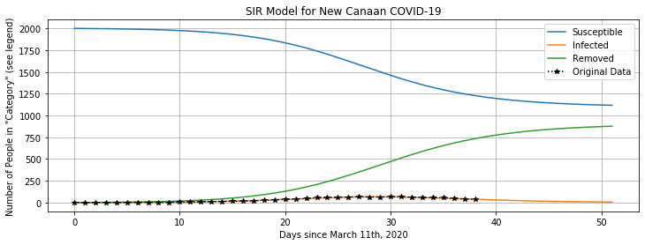
Today

Slide 17
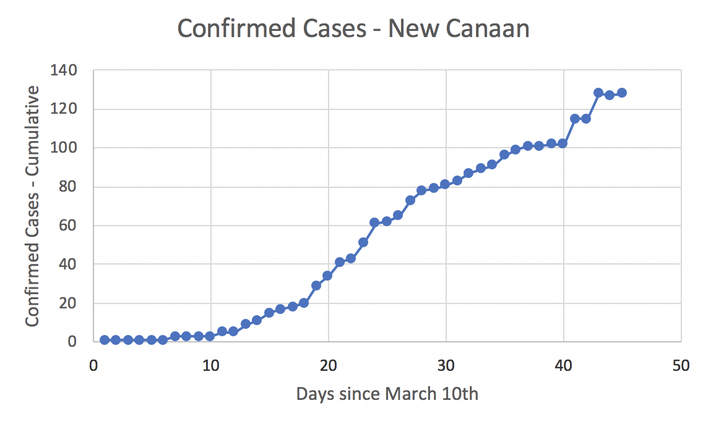
New Canaan Coronavirus Modeling
Apr. 25th Update
Batches of tests

Slide 18
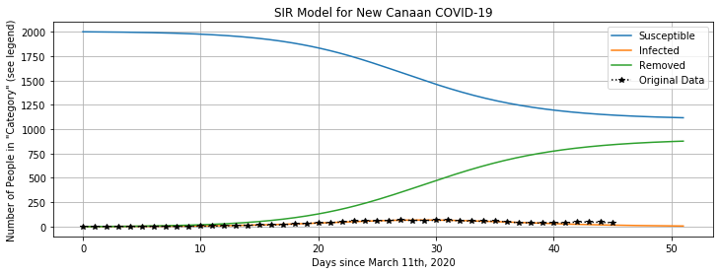
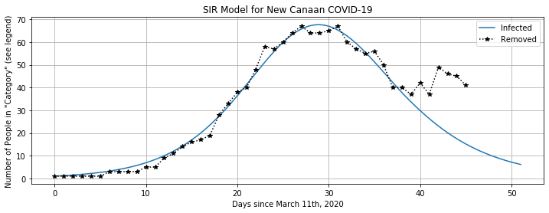
New Canaan Coronavirus Modeling
Apr. 25th Update

Slide 19
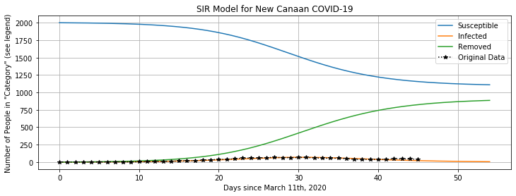
New Canaan Coronavirus Modeling
Apr. 25th Update
Similar Projections as Before!

Slide 20
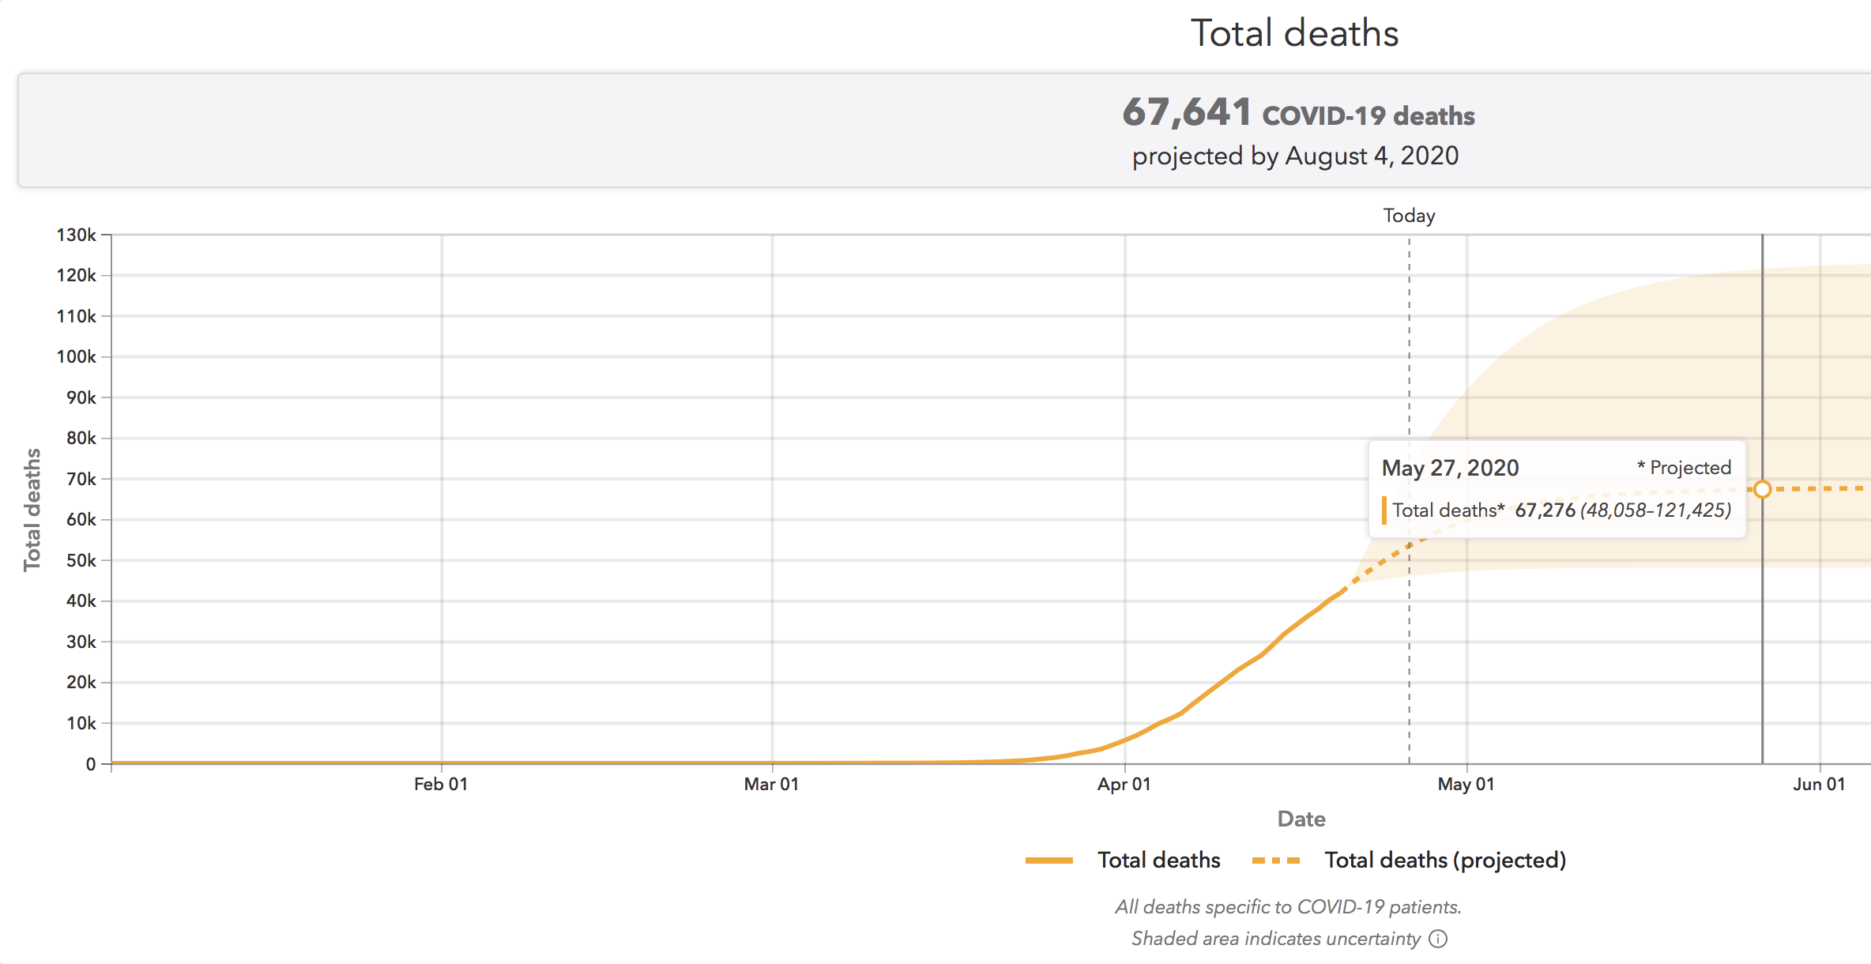
Coronavirus Modeling
Apr. 25th Update

Slide 21
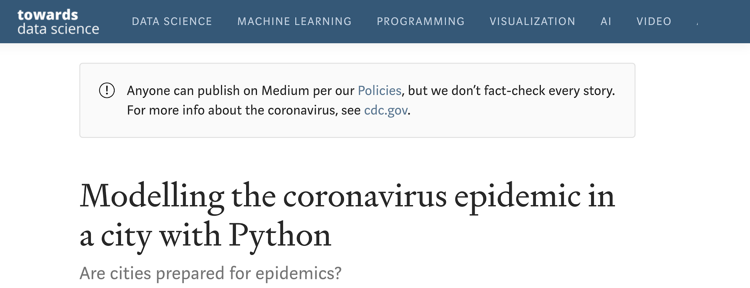
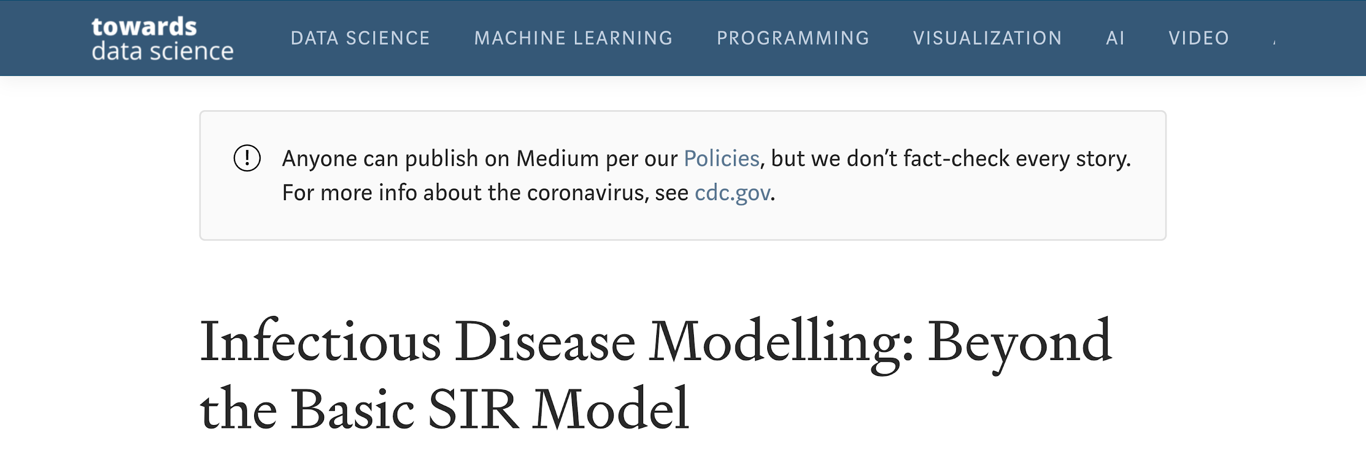
Epidemics Modeling - Data Science

Slide 22
Sources

